Slide 1

Front End Department Workshop
Wednesday October 11th

Slide 2
MVC (Model-View-Controller)
Three-Tier Model
Data Tier (Model) | Presentation Tier (View) | Logic Tier (Controller)
Data Retrieval Data Storage Persistence Languages: C#, SQL, noSQL, etc. | Web page Forms Controls (textboxes, etc.) Menus Navigation Languages: HTML/CSS, Razor, etc. | Business Objects Validation Calculations Business Logic Business Rules Languages: C#, JavaScript, ect.

Slide 3
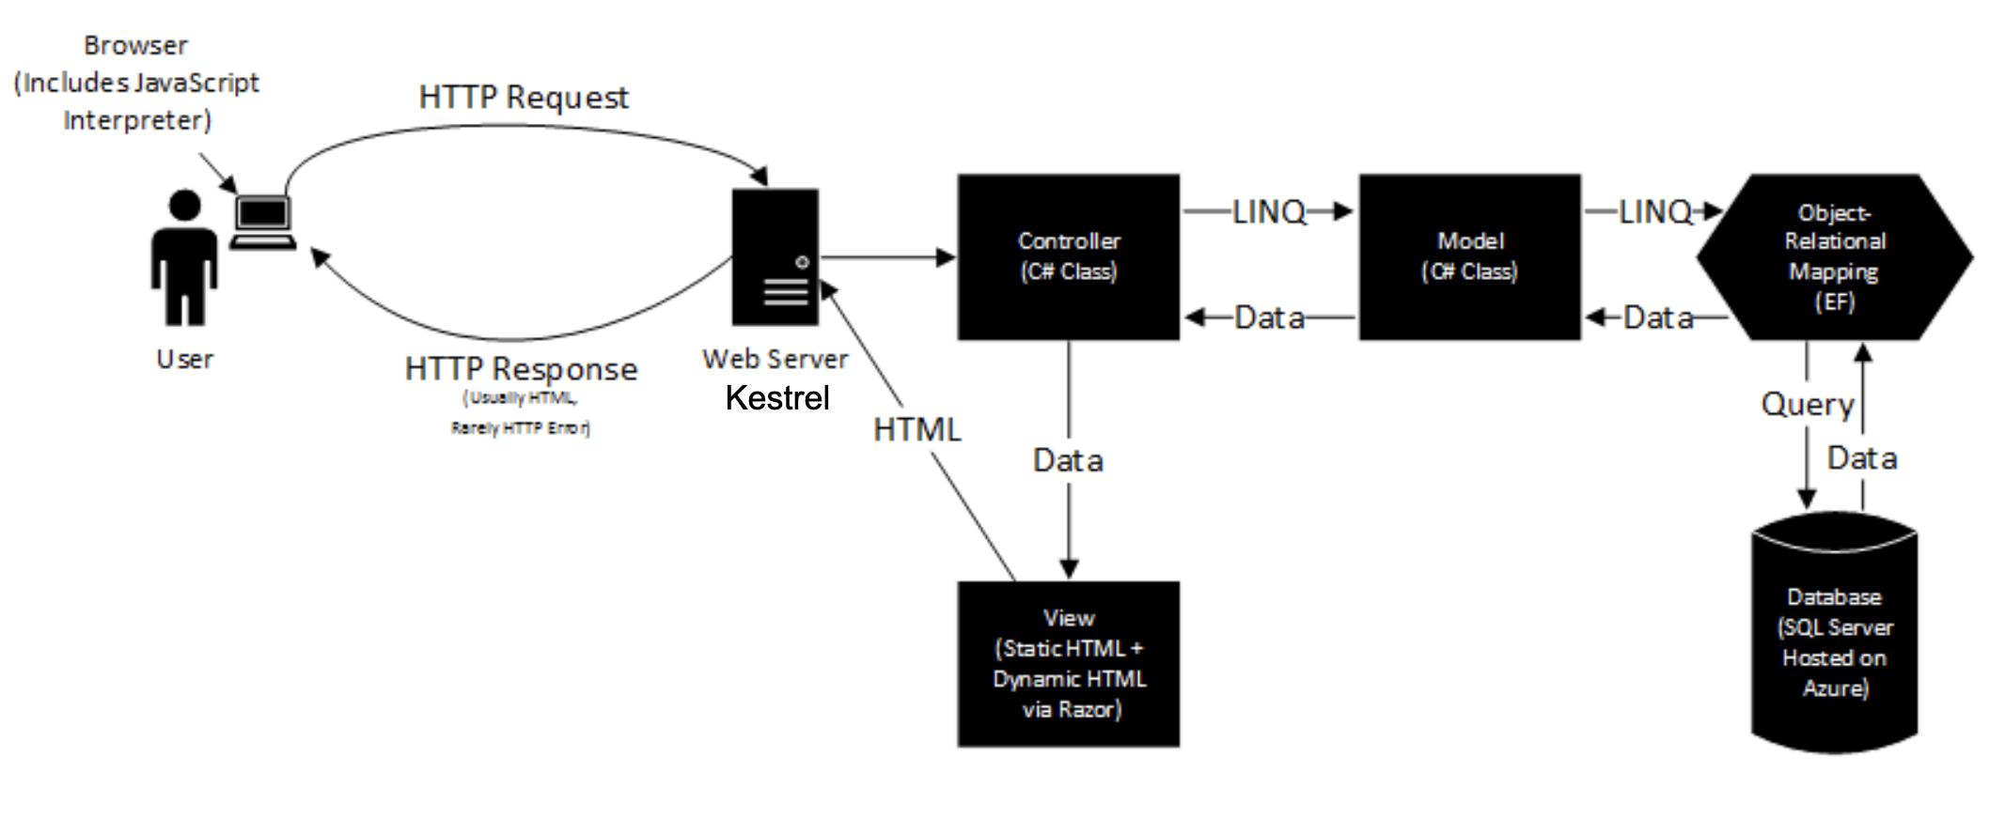
Map of MVC

Slide 4
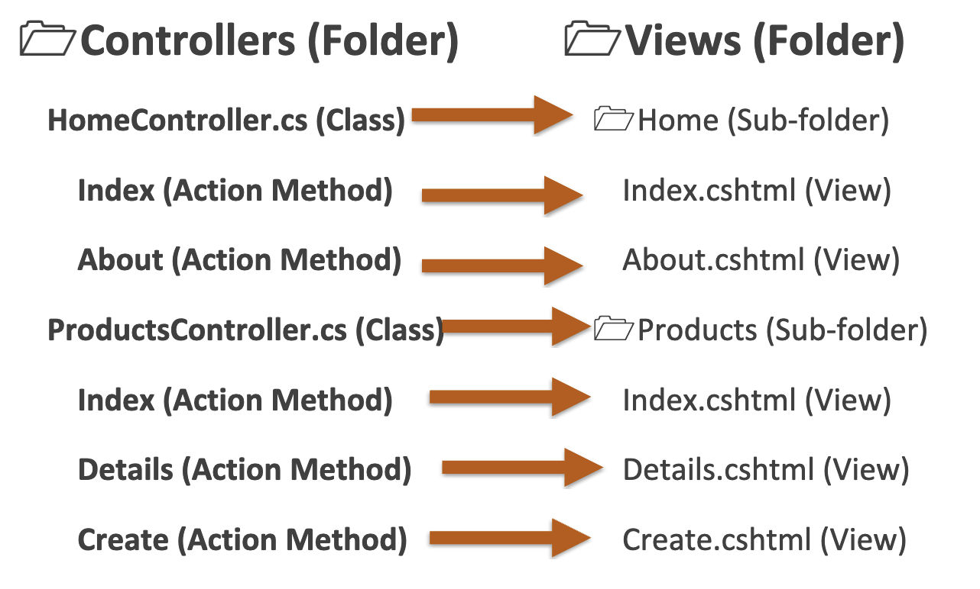
MVC Structure
CurrentProjects
CurrentProjects.cshtml (View)
SourceModel.cs (Class)
SoruceModel (Sub-folder)
Apply (Action Method)
Apply.cshtml (View)
Events (Action Method)
Events.cshtml (View)
FAQs (Action Method)
FAQs.cshtml (View)

Slide 5
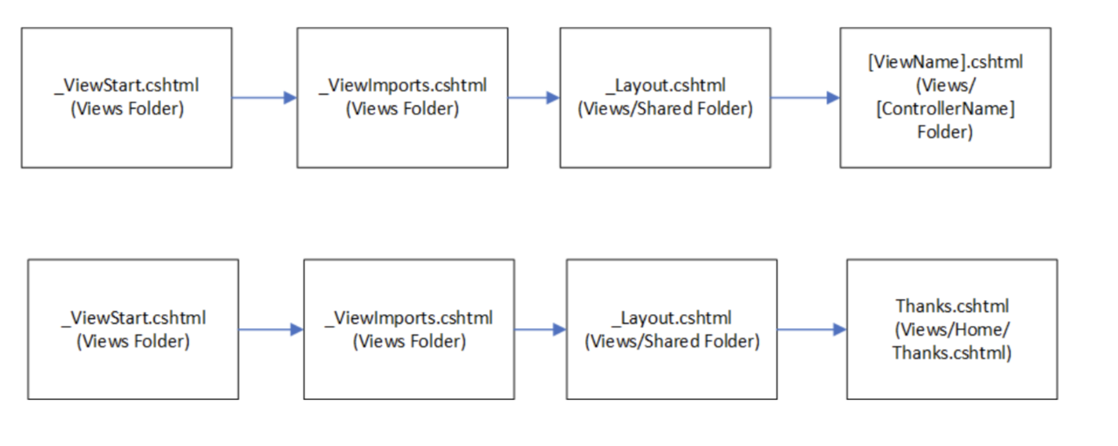
Creating a View

Slide 6
Getting Started
https://visualstudio.microsoft.com/downloads/
https://github.com/ethanmikel/texas-luminescence

